Slide 1

PASS
PERSONAL ASSISTANT STIMULATOR SYSTEM

Slide 2
FEATURES
Interactive
Manages your day
Helpful tools
Record keeper
Made for everyone
Self assessment

Slide 3
Technology
Java script
Html5
CSS
Canva
Adobe Lightroom
Adobe PS Express

Slide 4
User Requirements
A Desktop/laptop
An Operating System
A Browser

Slide 5
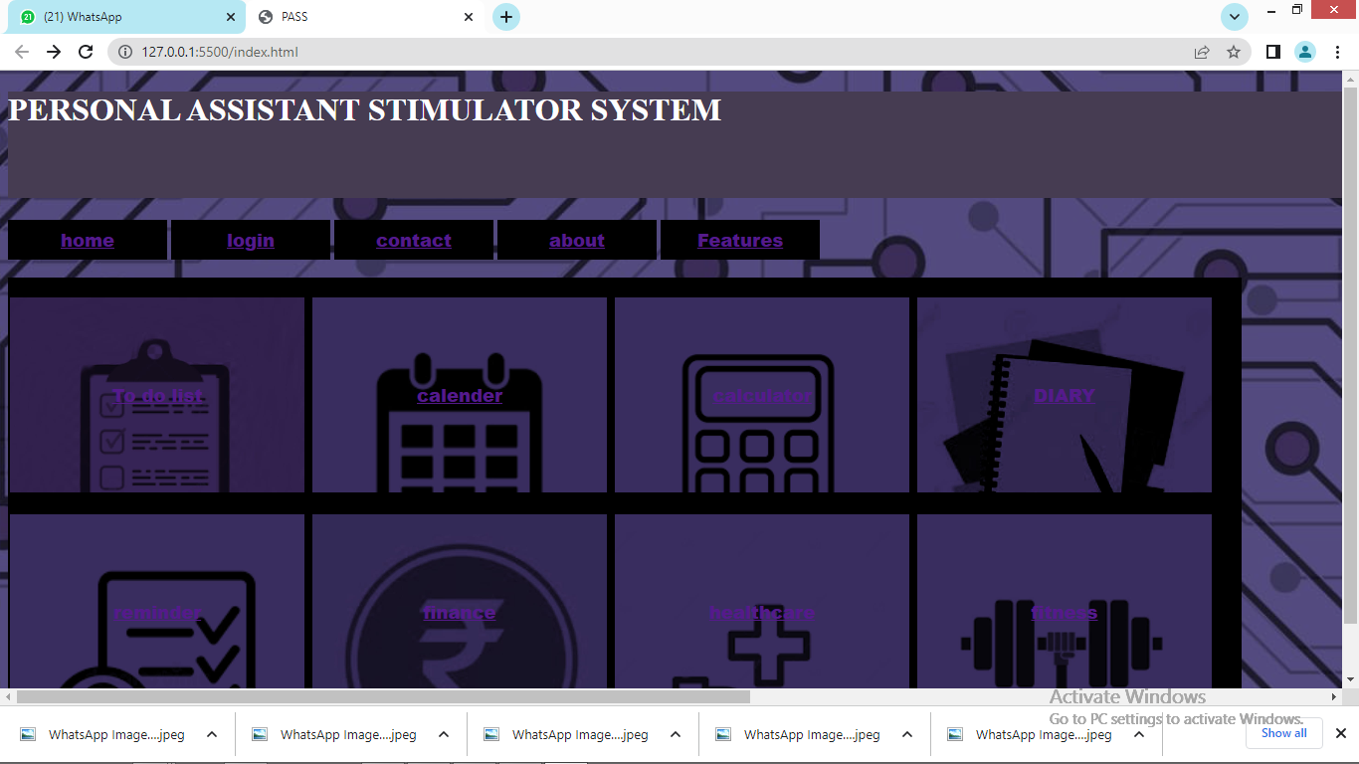
Home Page

Slide 6
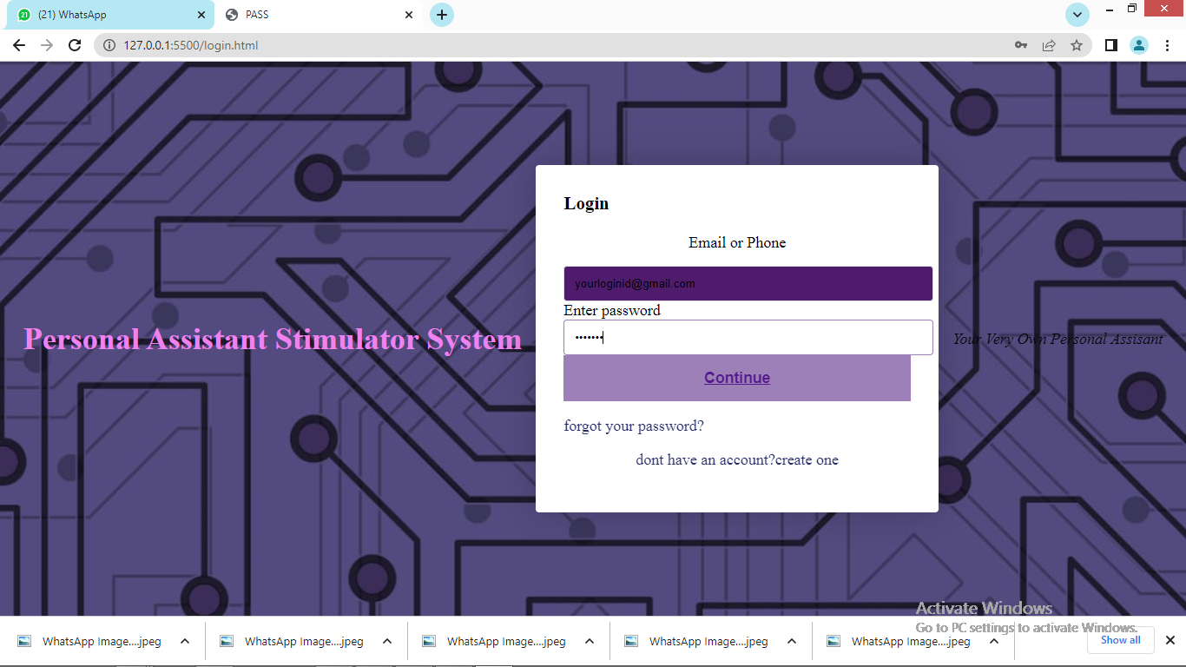
Login Page

Slide 7
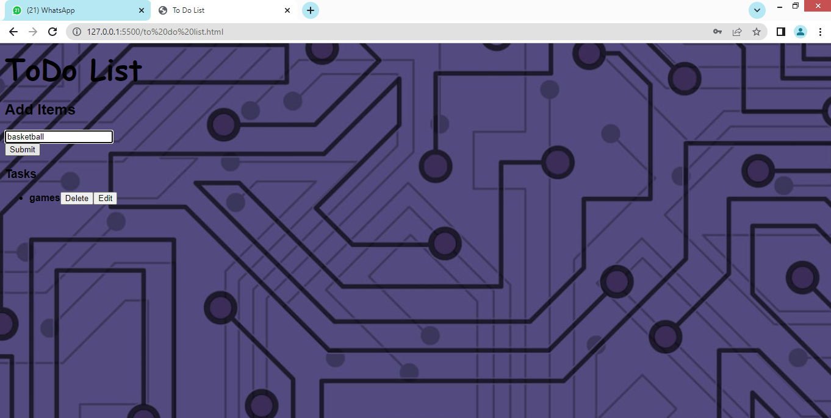
To do list

Slide 8
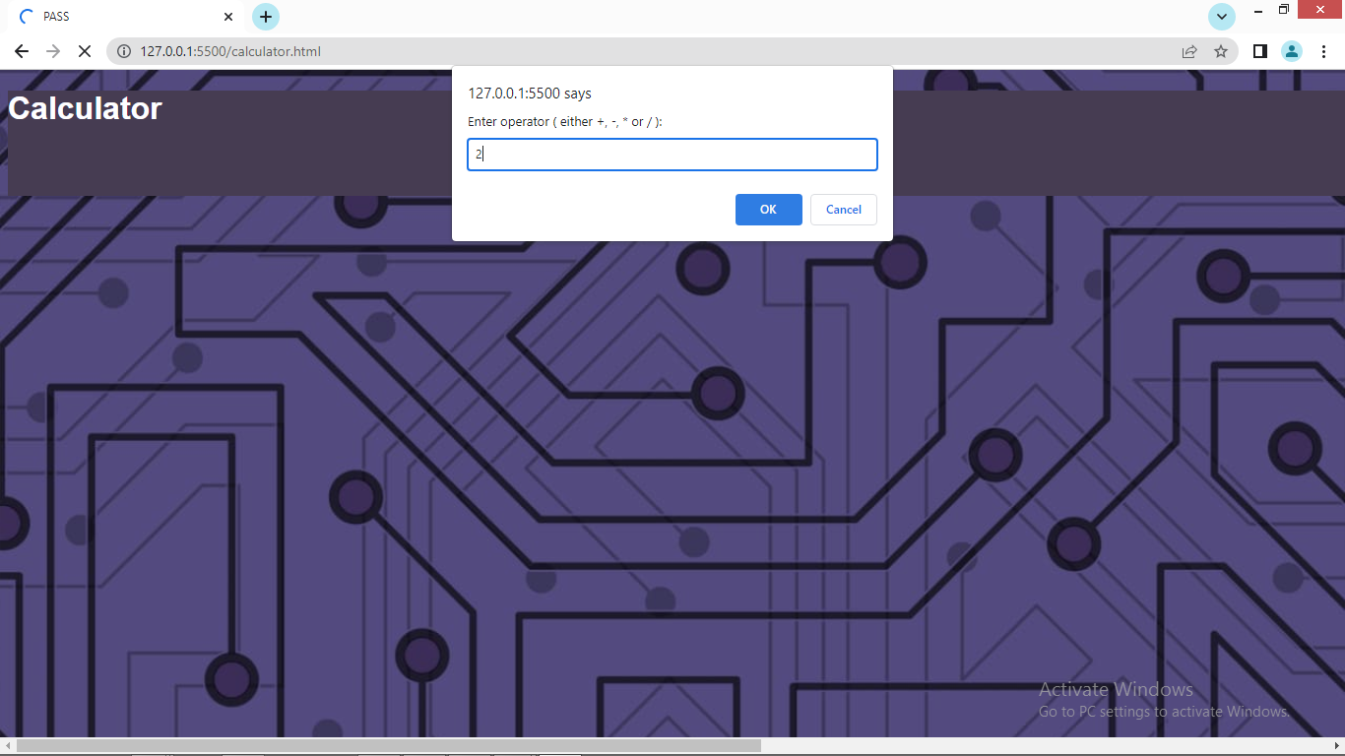
Calculator

Slide 9
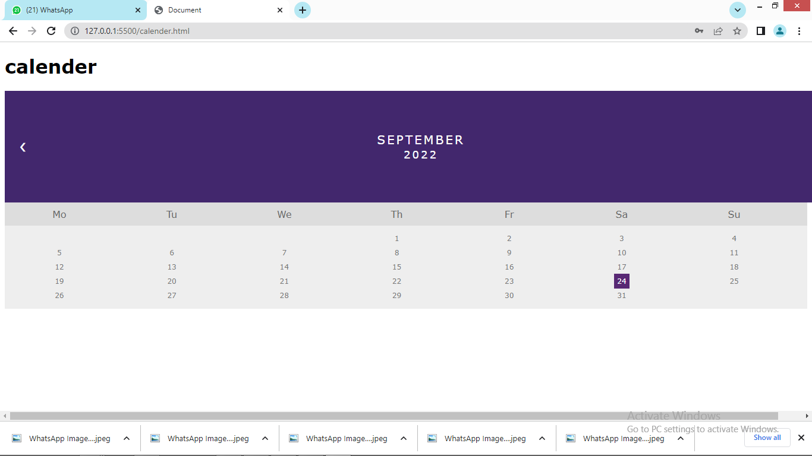

Slide 10
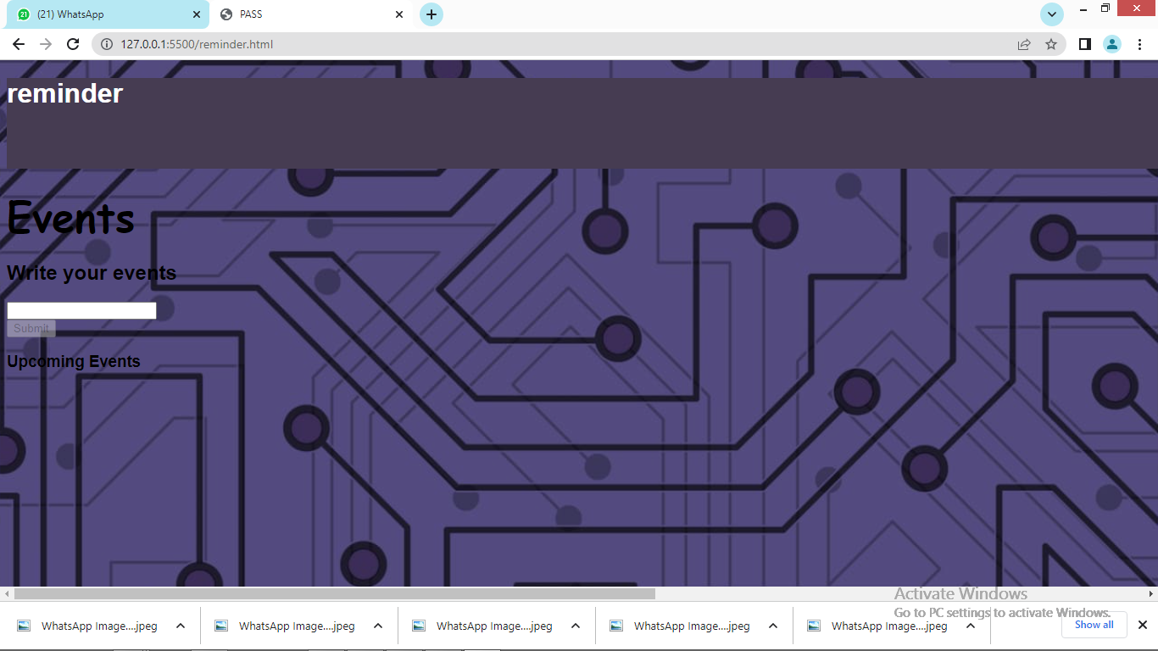
Event Reminder

Slide 11
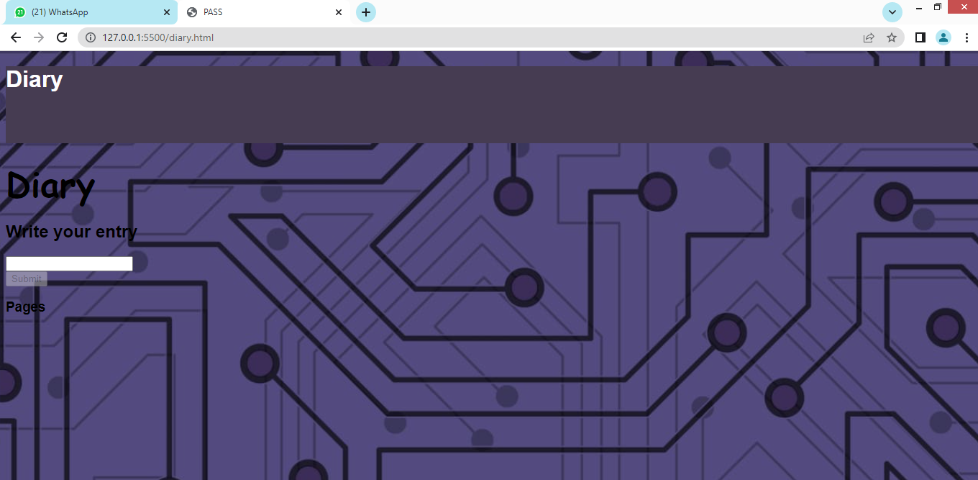
Diary

Slide 12
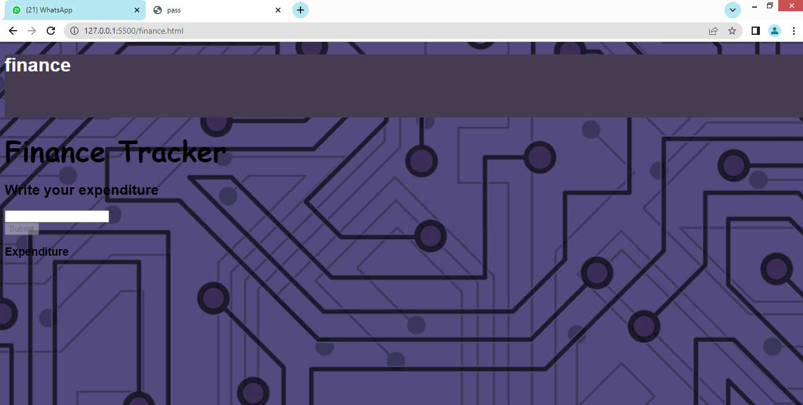
Finance

Slide 13
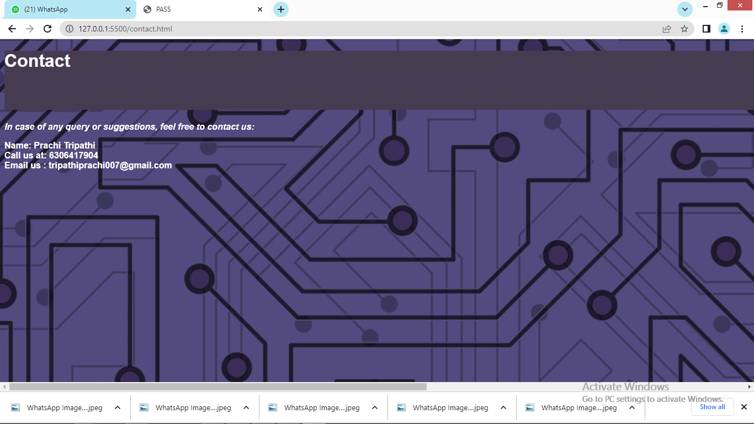
Feedback

Slide 14
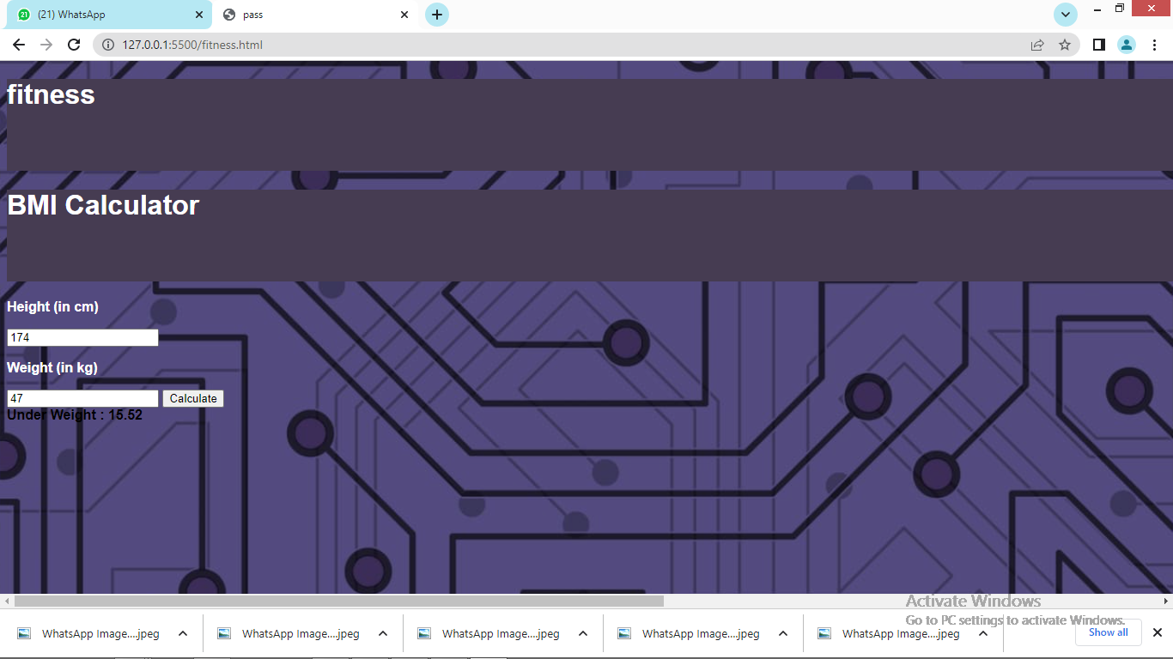
Fitness

Slide 15
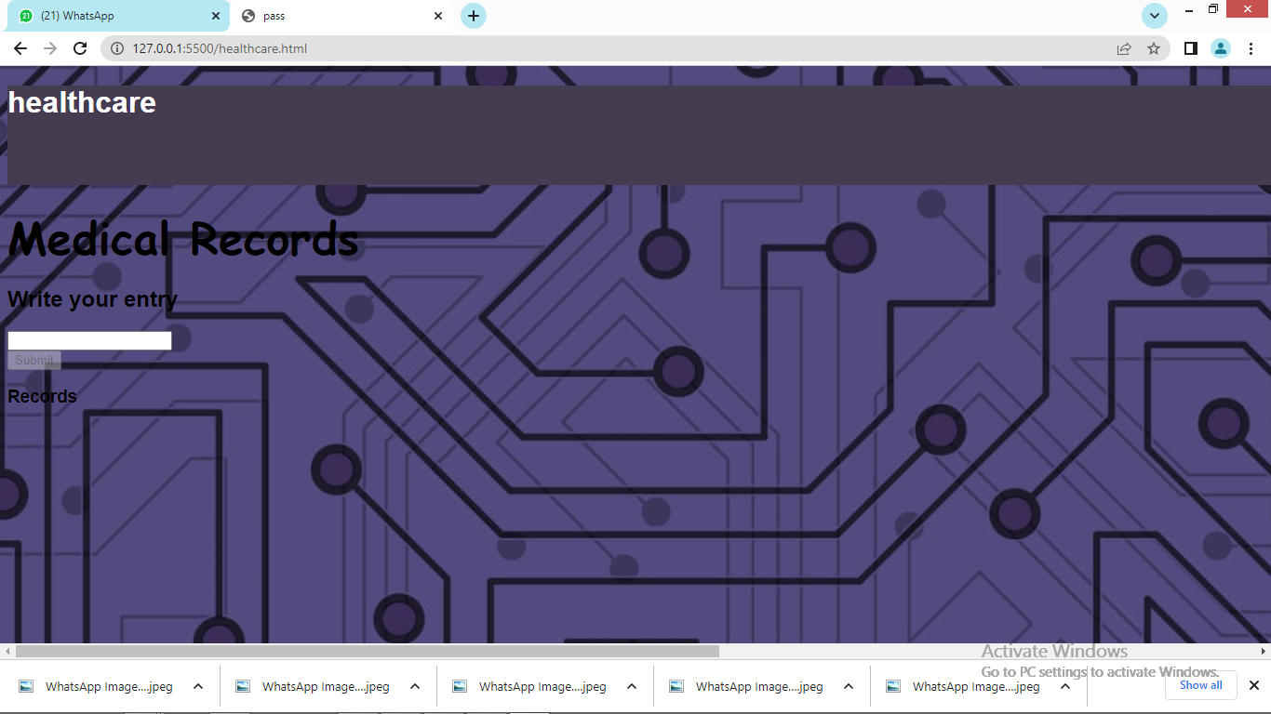
Healthcare

Slide 16

Thank you

